Slide 1
Microsoft SharePoint in Simple English
- By Aackose Mentu Lal

Slide 2

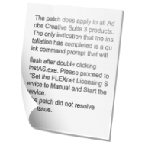
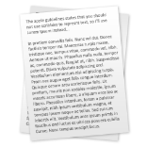





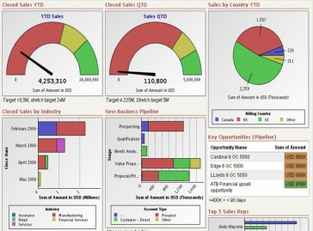
New Project starts
Team formed
Meetings scheduled
E-mails floating
Documents emerge
New Project Starts
Team formed
Meetings Scheduled
TEAM
MEETINGS
Emails Floating
Documents Emerge
CHAOS!!
Pile up of docs, mails, data, reports, deadlines, meetings
Multiple Version of docs
No Complete Snapshot
Data spread across machines
Diff. in Deadlines, schedules
Isolated Project Islands
No co-ordination or collaboration
CHAOS!!
Maurice, PM
Oh, Ok, June 1st
July 1st
It is!
P1
P2
P3

Slide 3
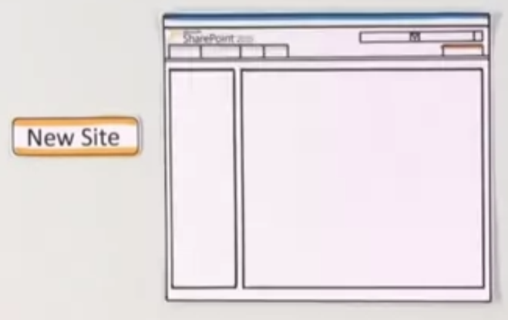
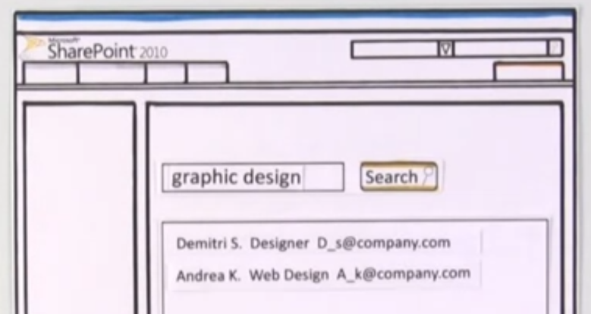



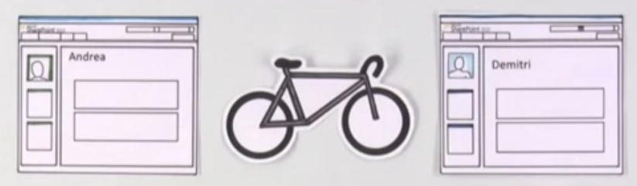
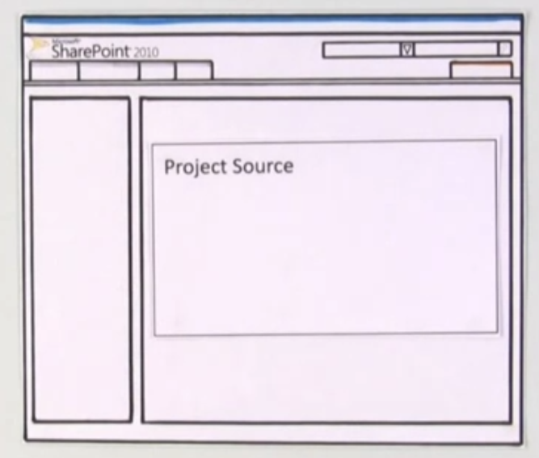

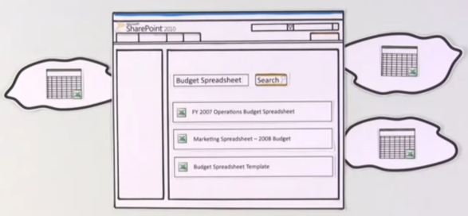


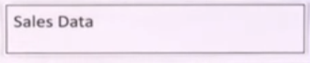
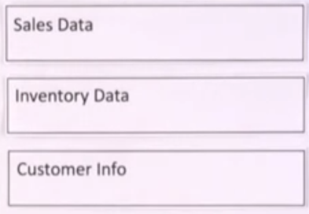
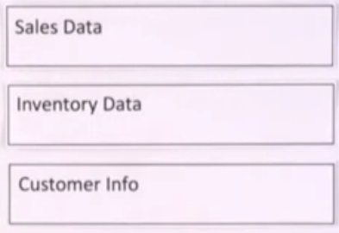
1
2
New Project starts – New Site
Search Members – SP Search
Creates a Team
Team bonding & Sharing – Blogs, Wikis
No missing schedules or wrong deadlines – SP Calendar, Alerts
SharePoint becomes the source for everything related to the project
Only one doc version in SP
Connect with other Project(s) \ Site(s) – documents, processes, templates
ORGANIZED!!
3
4
ORGANIZED!!
5
6
!! SHARE, SEARCH N COLLABORATE !!

Slide 4
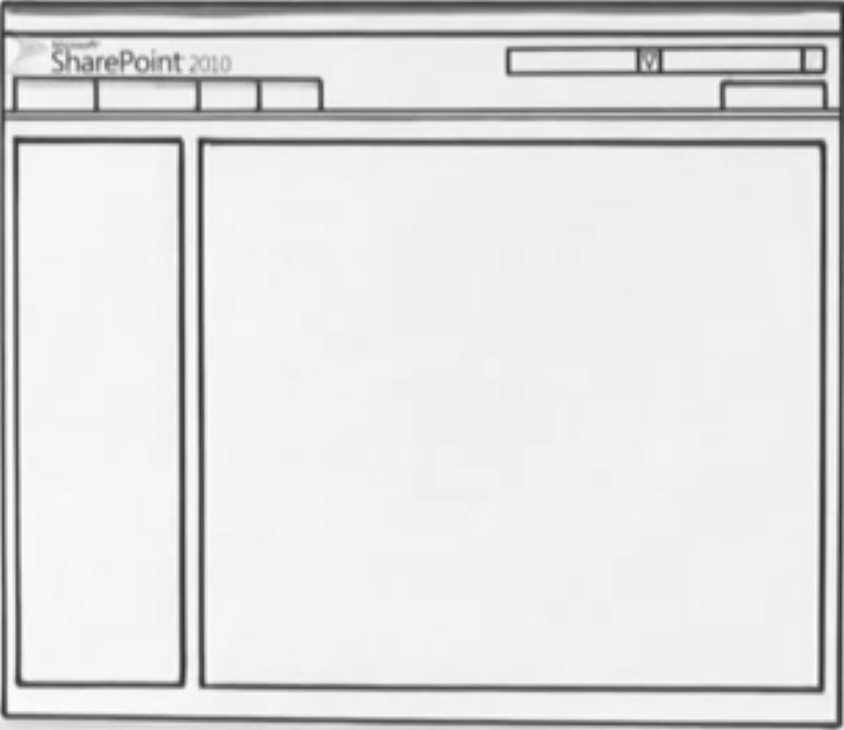


New Project starts – New Site
Search Members – SP Search
Creates a Team
Team bonding & Sharing – Blogs, Wikis
No missing schedules or wrong deadlines – SP Calendar, Alerts
SharePoint becomes the source for everything related to the project
Only one doc version in SP
Connect with other Project(s) \ Site(s)

Slide 5




